Slide 1
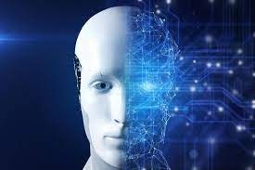
3D tracking of people from multiple
RGBD cameras in an operation room
Autors :
Monsarrat Samuel, Md Zilan Uddin Saif
Professor: Joan Aranda
Course: Advance Topics Computer Vision Project
Date: May 28, 2024

Slide 2
Contents
Introduction
T and I Pattern recognition
HOG Descriptor
DNN Algorithm
Socket to gather all data in one device
Calibration process
Conclusion

Slide 3
Introduction
Develop a reliable 3D tracking system using multiple RGBD cameras for real-time monitoring of medical professionals in operating rooms.
Deep Neural Networks live head detection, dlib for facial landmarks, Integral Image approach for efficient pattern recognition, and HOG descriptors for verifying human head patterns.
Utilizes a socket-based communication system for data transfer and synchronization between cameras and the central processing unit.
Employs Berthold K. P. Horn’s techniques to calculate the transformation matrix for accurate multi-camera perspective alignment and individual tracking.
real-time 3D tracking

Slide 4


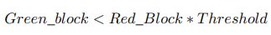
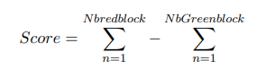
T-Pattern and I-Pattern detection 6 blocks
Integral image computation
Average value per block
Threshold to consider a pattern
Score implementation
Number of error allowed

Slide 5
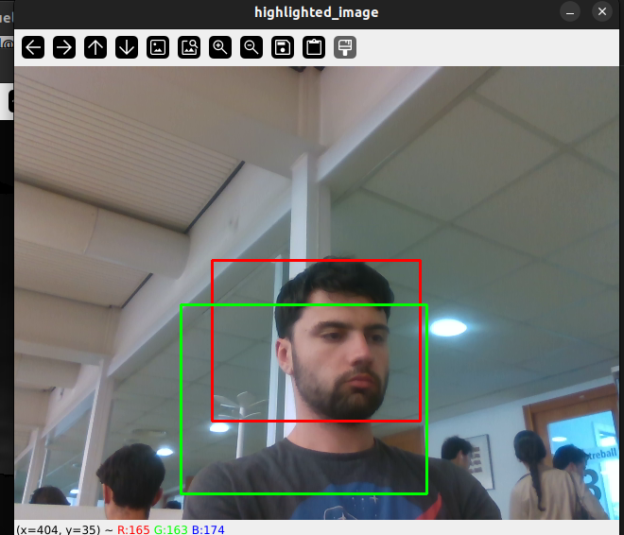
T-Pattern and I-Pattern with 6 blocks result

Slide 6
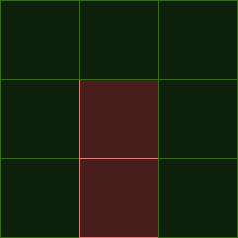

T-Pattern and I-Pattern detection 9 blocks
New pattern to have complete head tracking

Slide 7
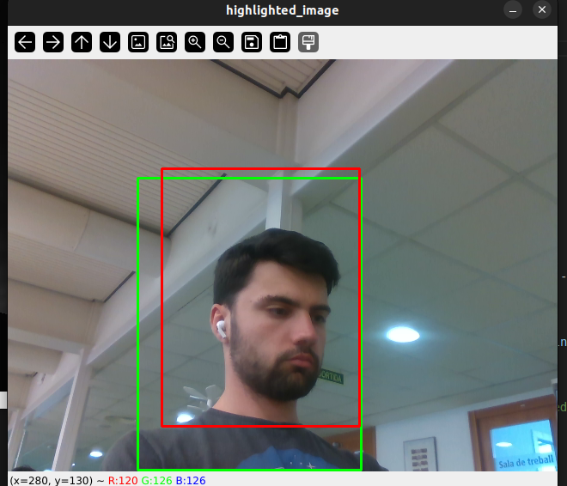
T-Pattern and I-Pattern with 9 blocks result

Slide 8
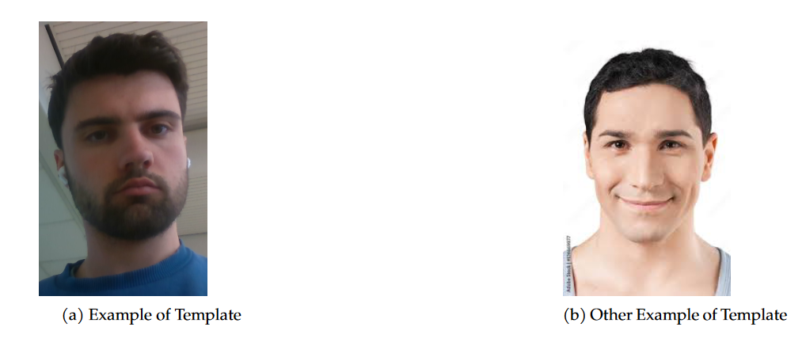
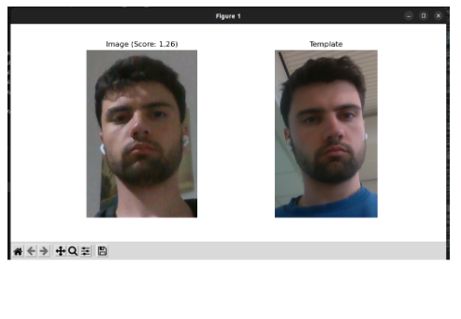
Hog Descriptor
Distribution Gradient
Calculate Gradient Magnitude (Sobel filter)
Orientation binding (8x8)
Template matching

Slide 9
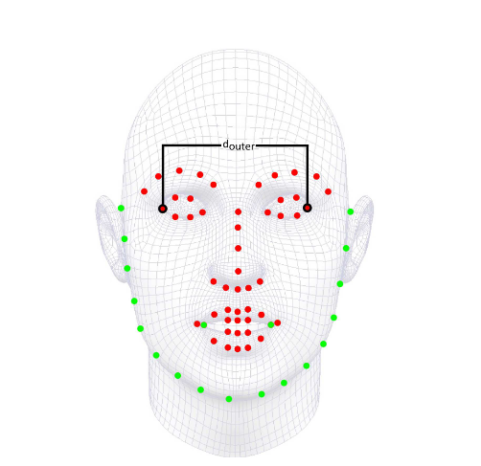
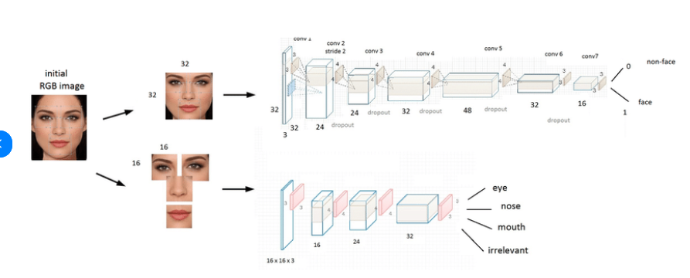
DNN Algorithm

Slide 10
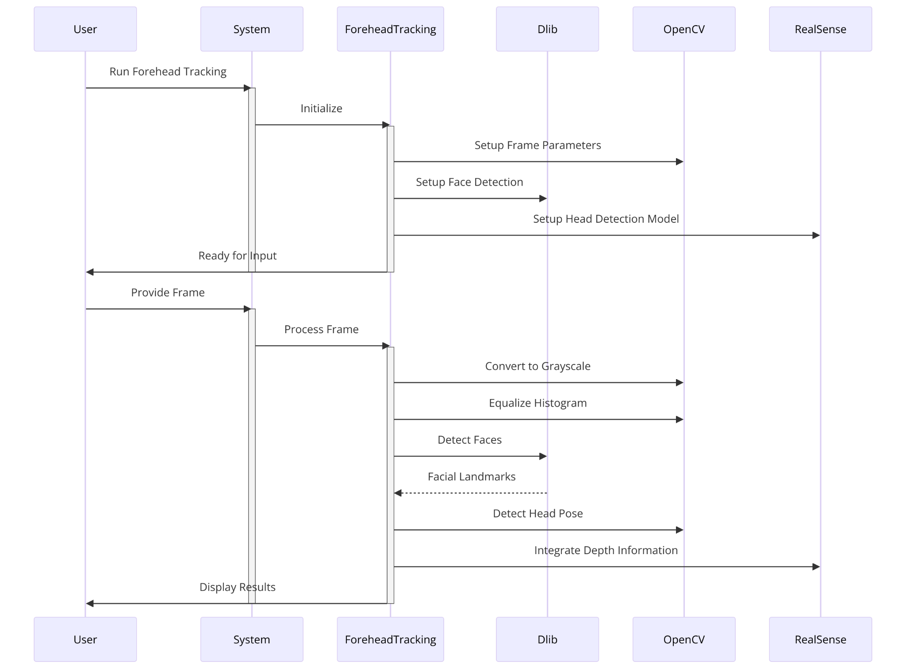
DNN Algorithm

Slide 11
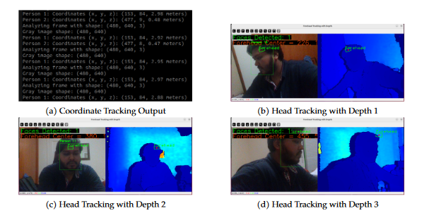
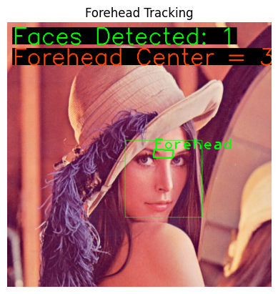
Results From DNN Algorithm

Slide 12
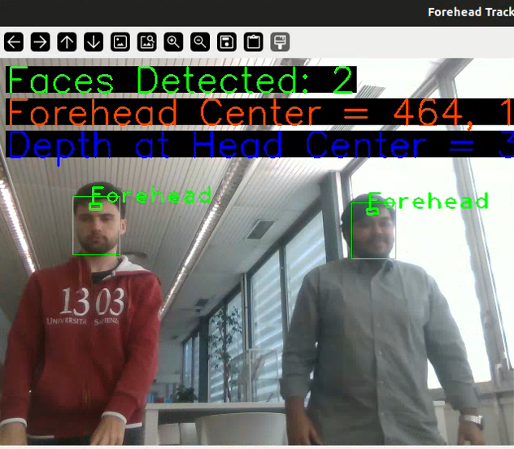
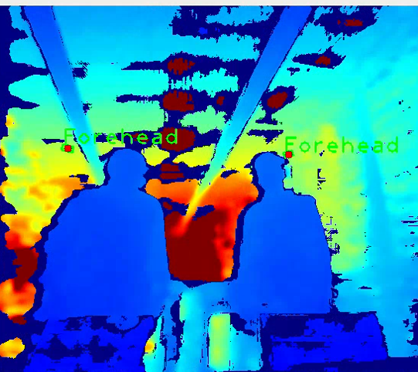

Slide 13
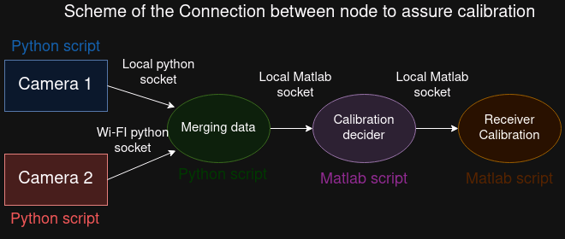
Socket architecture

Slide 14
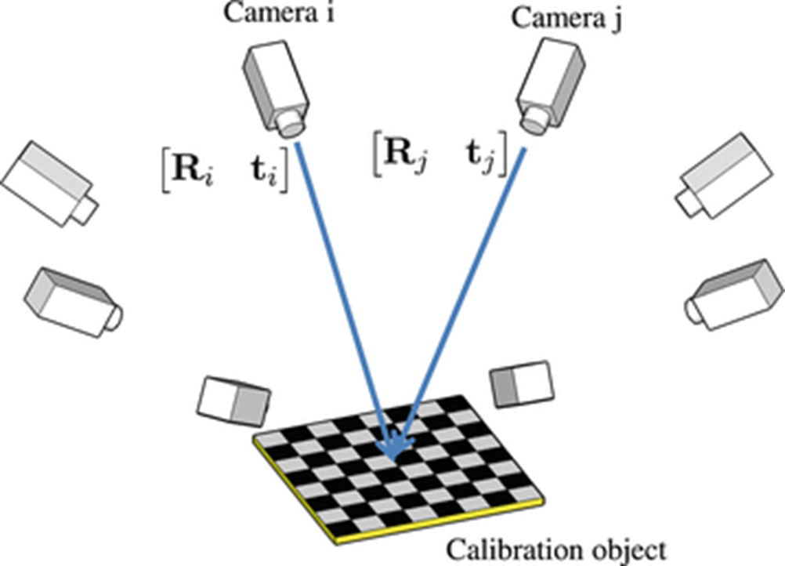
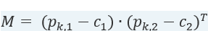
Absolute orientation problem
•Computation of the centroid
•Computation of the relative coordinates
•Computation of the optimal rotation matrix
•Computation of the translation
•

Slide 15

Multi Tracking Result

Slide 16

Conclusion
Possible improvements
Accomplishments
Positive / negative points

